Slide 1
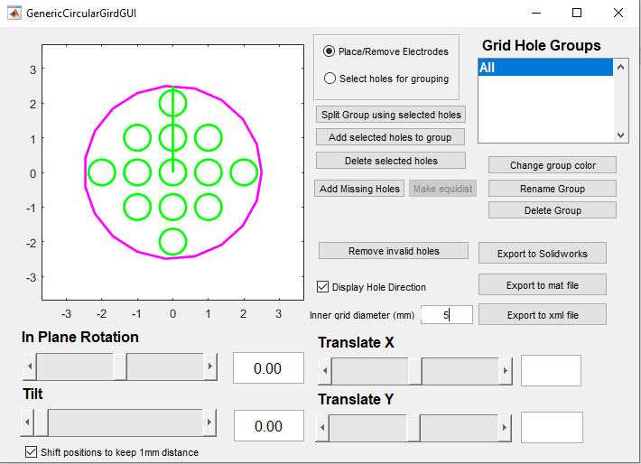
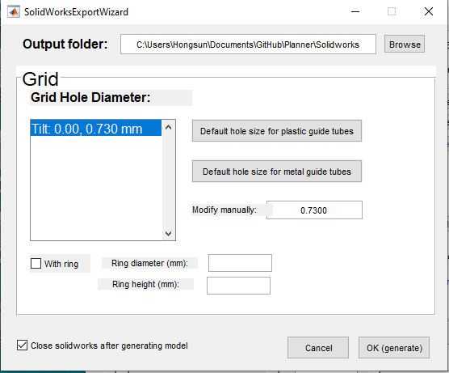
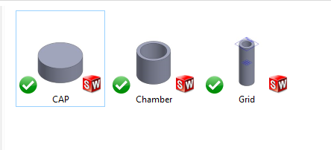
Note: Only support Solidworks 2019; Old ‘SolidworksExportWizard’ will be used if you have an earlier version of Solidworks installed.
2) Click here to export chamber, cap, grid
1) Change the grid inner diameter
3) Select the folder where you want to generate Solidworks files.
4)
Click OK. Then the files are generating.
5) You will find 3 files in the folder you selected in step (3).

